Slide 1
Contractor Management
Ori Chanael and Donner Hanson

Slide 2
Inspiration
Ori’s father has a contractor business
We wanted a system to easily:
Manage employees
Track data
Manage some Finances

Slide 3
What Is It?
Contractor/Construction management system
Easily manage and analyse:
Jobs
Employees
Clients
Subcontractor Contacts

Slide 4
Jobs
Easily create and alter various jobs
Check which salespeople and subcontractors are attached to any given job
Track various status changes:
Lead
Accepted
Finished
Canceled
Check the average cost and compare jobs with greater or lesser costs

Slide 5
Users
Users are the Company’s administrative, sales, and finance staff
Create, alter, and (soft) delete various employees
Employees are separated via a Role ID
Track which employees are attached to which Job
Sales, finance, marketing can all have attachments to various non-distinct jobs

Slide 6
Clients
Create, alter, and (soft) delete various Clients
Track how many Jobs a Client has
Track how much the Client has paid from all their Jobs

Slide 7
Contacts
Create, alter, and (soft) delete Contacts for various Subcontractors
Search for specific Contacts, such as Plumbing or Roofing companies
See which Contacts are attached to which Jobs

Slide 8
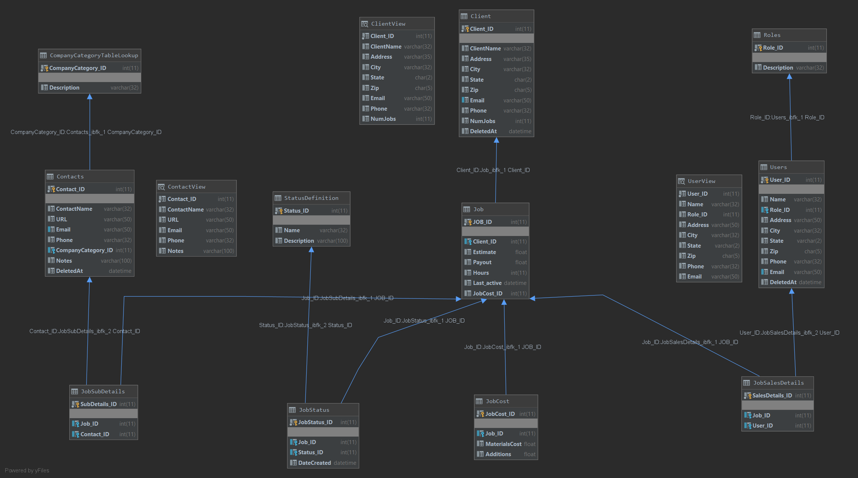

Slide 9
Data Export
Implemented fully structured data export to be easily used in excel and other CSV programs
Would like to implement parameterized CSV reports that can be used for varying departments

Slide 10
Learning Points
We switched our project relatively early as we had no experience with API’s
Destiny Clan Manager - would like to delve into that when we have adequate time
Designing a database for an entire company can get big quick
Scope of project quickly grew as time went on
Even with cutting various features, was still a huge project

Slide 11
Future Additions
Build out and integrate a UI
Companion app to handle financial transactions
Quickbooks is an existing example
Build out more customizable search options
Currently has a very stringent logic flow
Would like to build out a more “intuitive” workflow
Login/Verification
Logging System

